Slide 1

Halifax
Joint Rescue Coordination Center
Canadian SAR System

Slide 2
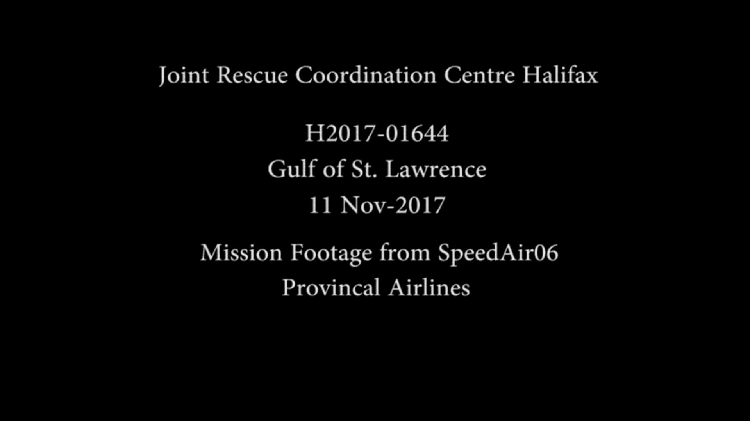

Slide 3
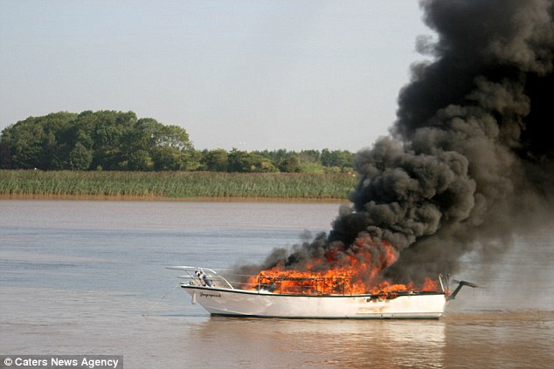
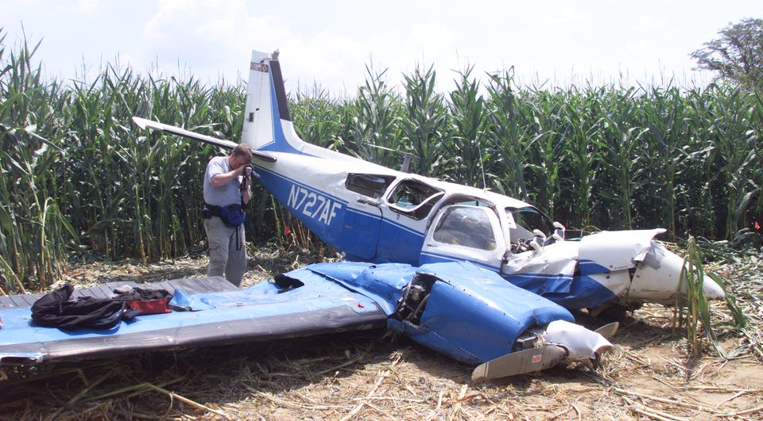
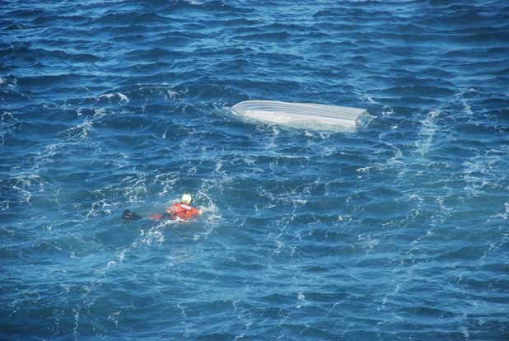
CANADIAN SAR MANDATE
The Canadian Federal Government’s National SAR Objective is to “prevent loss of life and injury through search and rescue alerting, responding and aiding activities using public and private resources”.
To meet that objective, DND and DFO/CCG are mandated to assume Federal responsibility for Aeronautical and Maritime SAR operations.

Slide 4
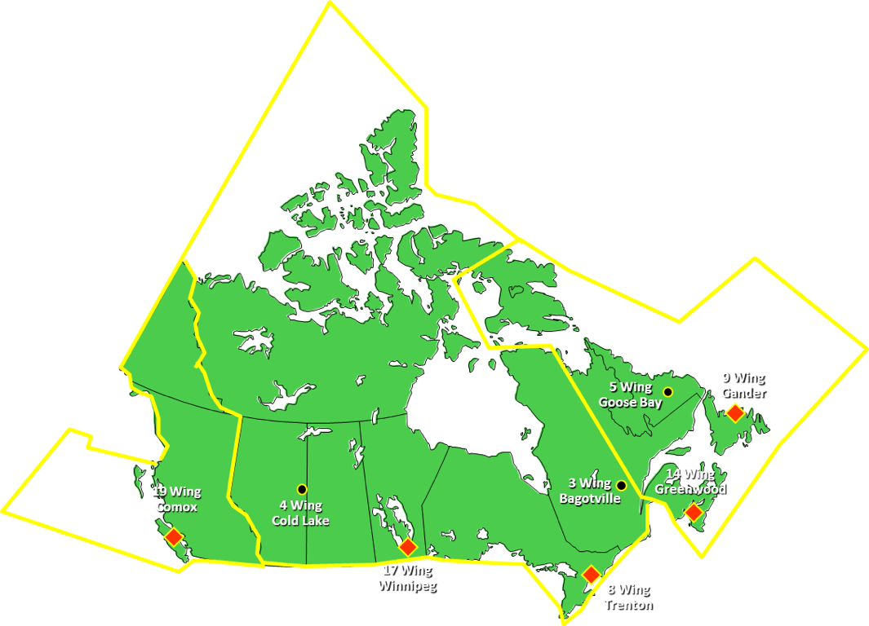
SEARCH & RESCUE REGIONS
Canada’s Area of Responsibility is 15,540,000 square kms

Slide 5
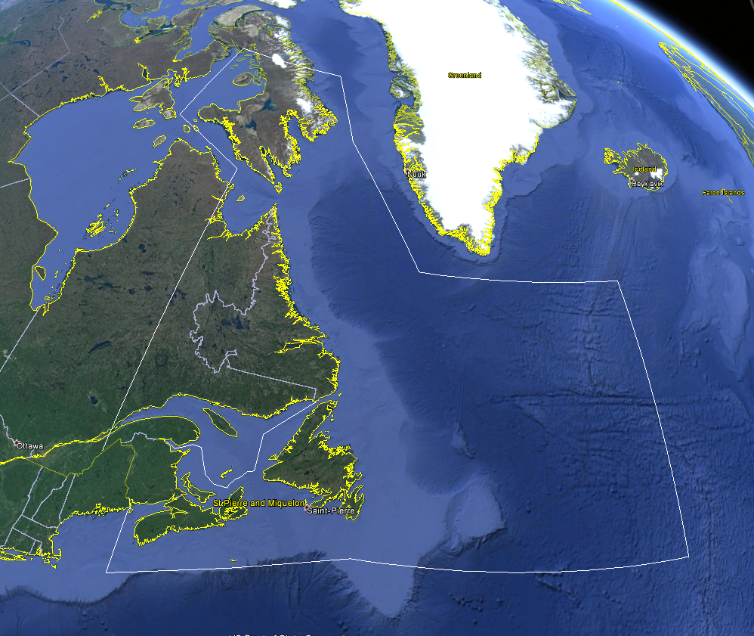
Halifax SRR
30 West
MRSC Quebec
JRCC Halifax
- 5.5 million square kms
- Over 74,000 kms of Coastline
- 80% of the Region is covered by water

Slide 6
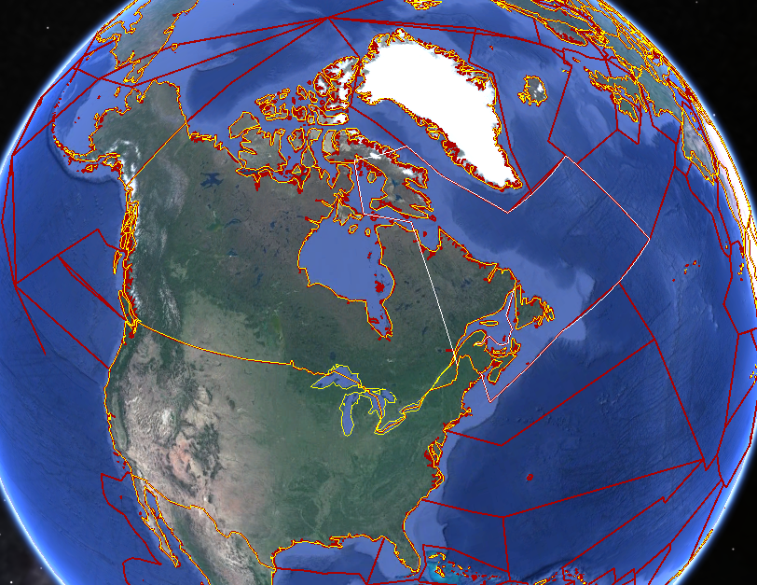
SRR NEIGHBOURHOOD
Iceland
Greenland
Alaska
Aberdeen
Falmouth
Juneau
Halifax
Victoria
Ponta Delgada
& Lajes
Seattle
Trenton
Boston
Alameda
Norfolk
AFRCC
Miami
San Juan

Slide 7
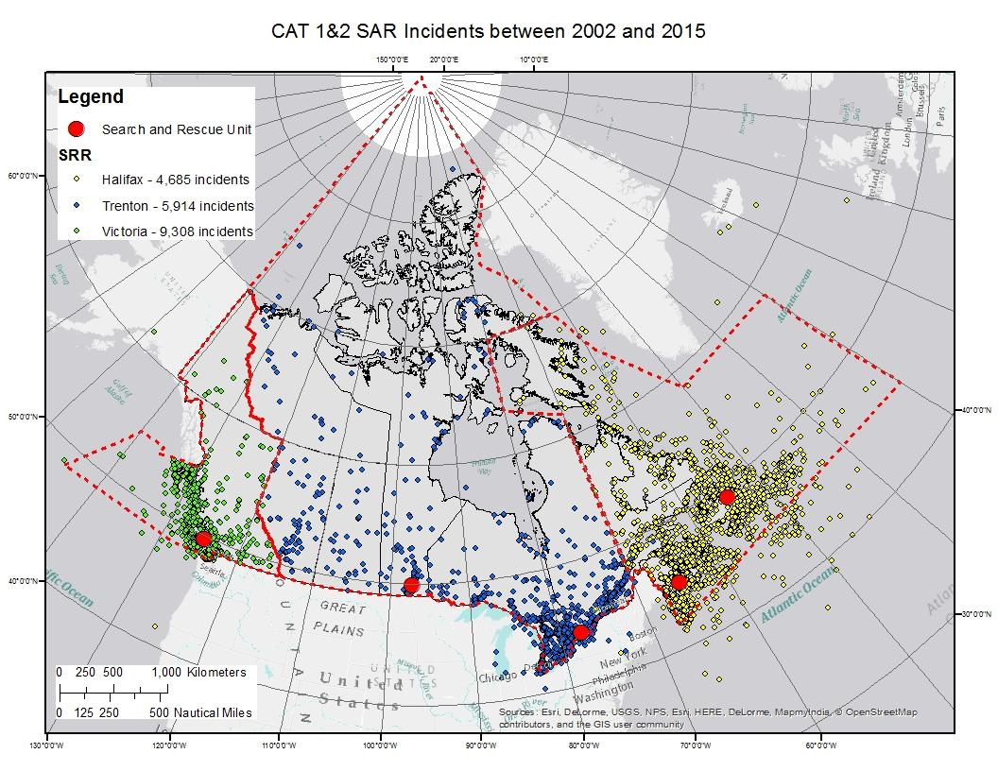
SAR ACTIVITY
CAT 1 & 2 INCIDENTS
Greenland

Slide 8
SAR ALERTING
How the JRCC finds out about the distress situations:
  Emergency beacons (EPIRBs, ELTs, PLBs & SPOTs)
  Emergency Communications (radio, telephone, SAT phone, cellphone)
  Concerned Citizens
  Public Safety Access Points (PSAP), 911

Slide 9
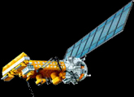
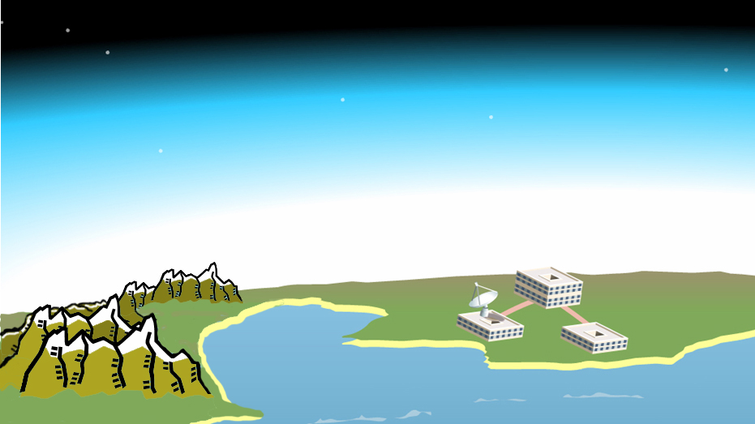
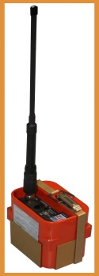
SARSAT System
Satellite detection (since 2009 processes 406 MHz signals only)
_{406 coded signal}
SAR Response
Canadian Mission Control Centre
RESCUE!
Ground Station (LUT)
JRCCs
Distress beacon (406 ELT, EPRIB or PLB)
Notes:
Take the ‘search’ out of Search and Rescue

Slide 10
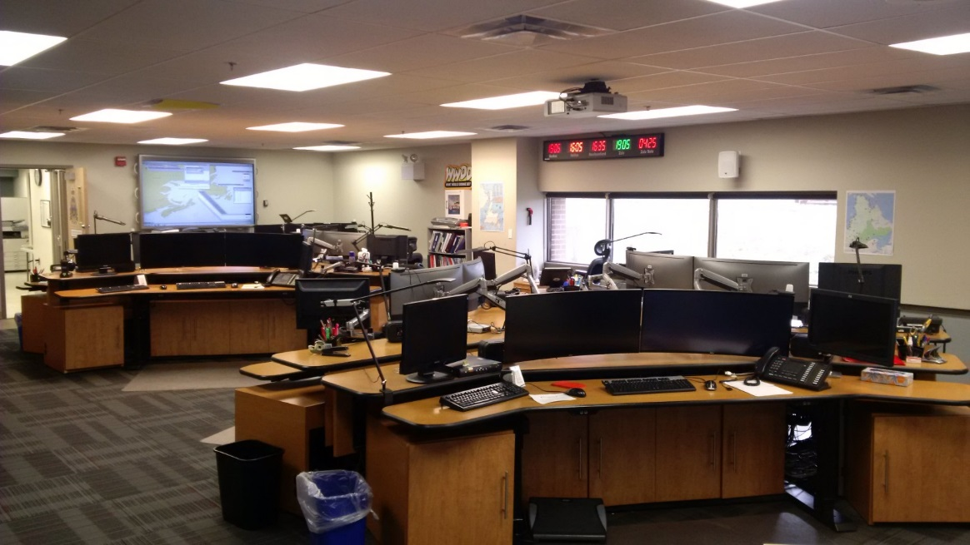
STAFFING
3 Maritime Coordinators:
  experienced Coast Guard Officers with time at sea
1 Aeronautical Coordinator:
  experienced Air Force Officers with time on a SAR Sqn as either pilot or navigator
1 Assistant Aeronautical Coordinator:
  Air Force NCM
24 hour operations, 12 hour shifts

Slide 11
RESPONSIBILITIES
Coordinate, control and conduct aeronautical and maritime SAR Operations.
Coordinate SAR unit responses to humanitarian incidents in accordance with national policies and regional directives.
Canadian Air Force provides SAR air assets and aircrews.
Canadian Coast Guard provides SAR marine assets and crews.

Slide 12
PRIMARY SAR RESOURCES
DND
  Cormorant
  Hercules
CCG
  Multi-task vessels assigned to SAR
  Life Boat Stations
  Inshore Rescue Boat Stations (summer only)

Slide 13
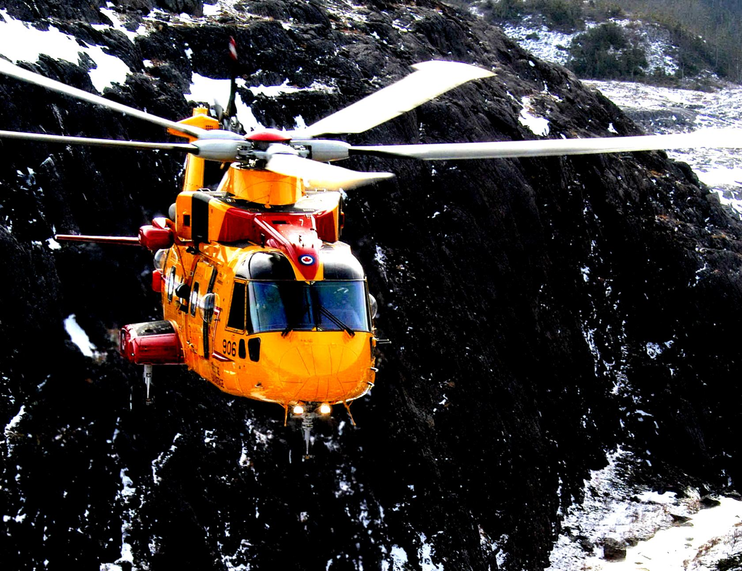
CH-149 PERFORMANCE
Cruising Speed:
Range:
Endurance:
T.O. Weight:
Engines:
Passengers:
145 Knots (268 km/h)
750 NM (1390 kms)
4.5 hrs
14,600 kg (32,187 lbs)
3
seating for 10 if SAR configured or 4 stretchers

Slide 14
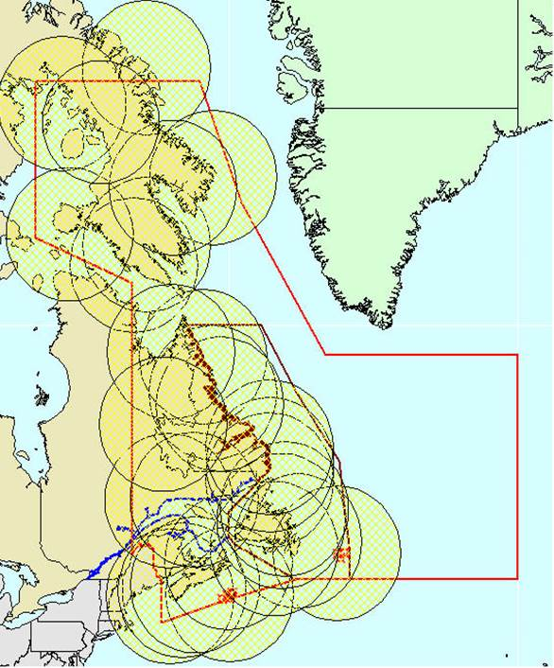
CH-149
OUT &
BACK
RANGE
200 NM

Slide 15
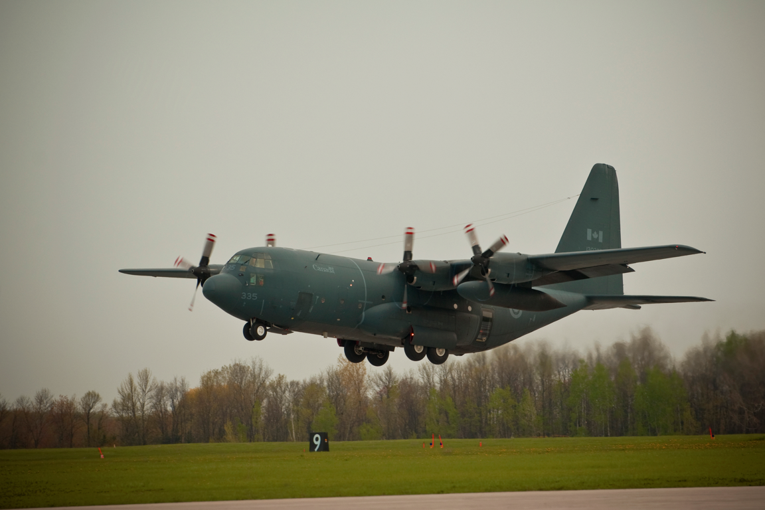
CC-130 HERCULES

Slide 16
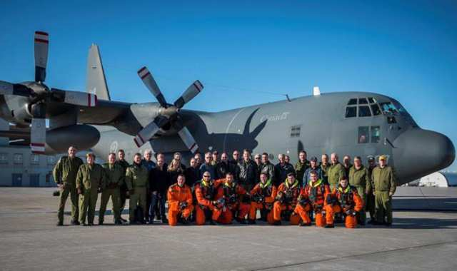
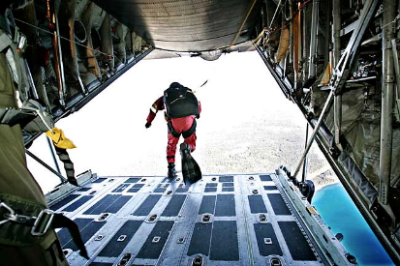
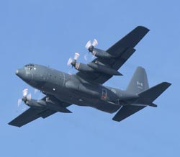
CC-130 HERCULES
Cruising Speed:
Max Altitude:
Range:
Endurance:
T.O. Weight:
Wingspan:
Length:
Height:
Engines:
Max Payload:
300 Knots (555 km/h)
35,000 ft
3600 NM (6670 kms)
12 hrs
154,000 lbs (69,850 kg)
133 ft (40.5 m)
98 ft (30 m)
38 ft (11.5 m)
4 X Allison T-54
30,000 lbs (13.600 kg)

Slide 17
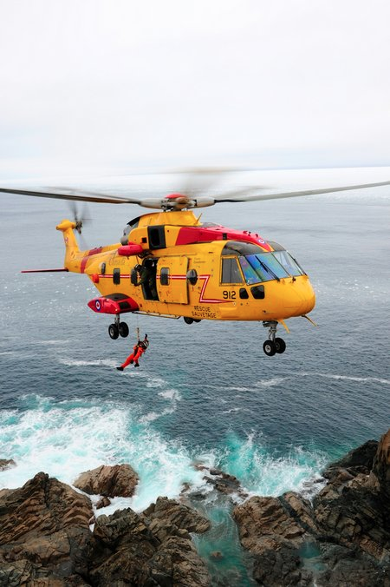
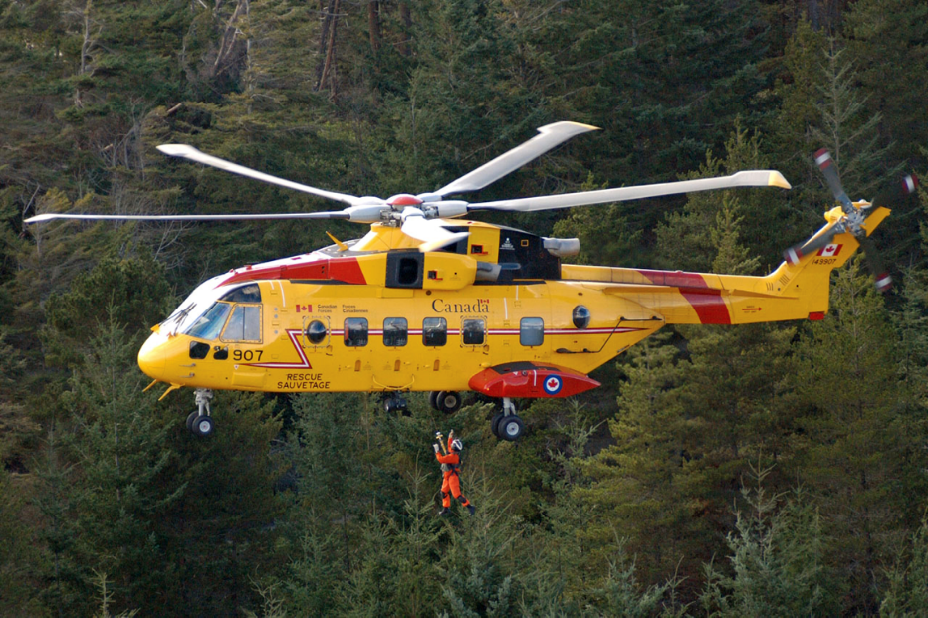
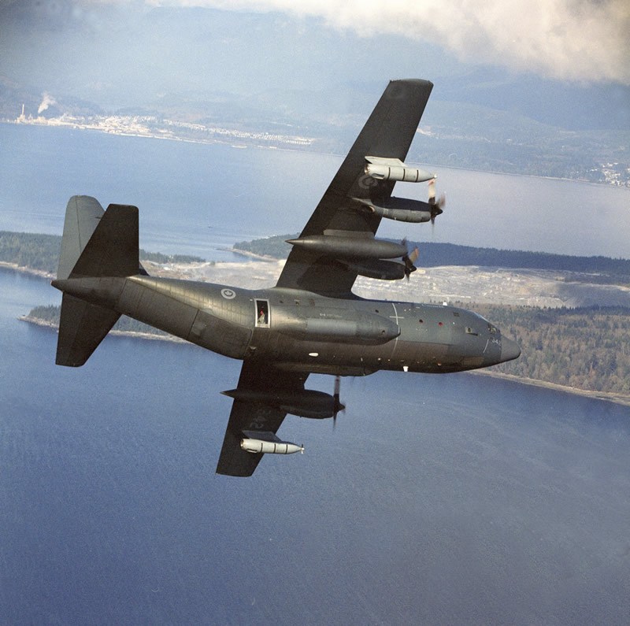
SAR AIRCRAFT STANDBY POSTURE
30 minute response during the work day
2 hour response during quiet hours

Slide 18
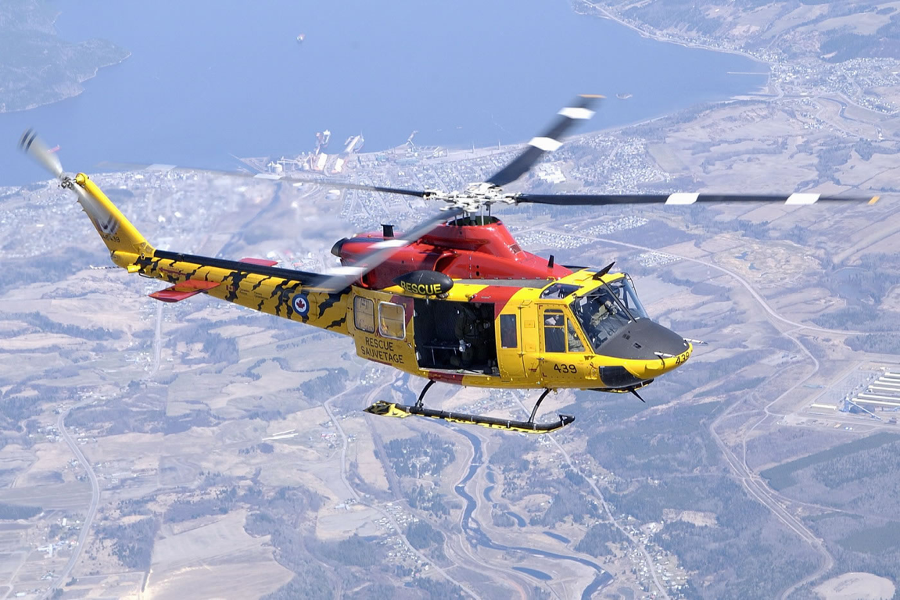
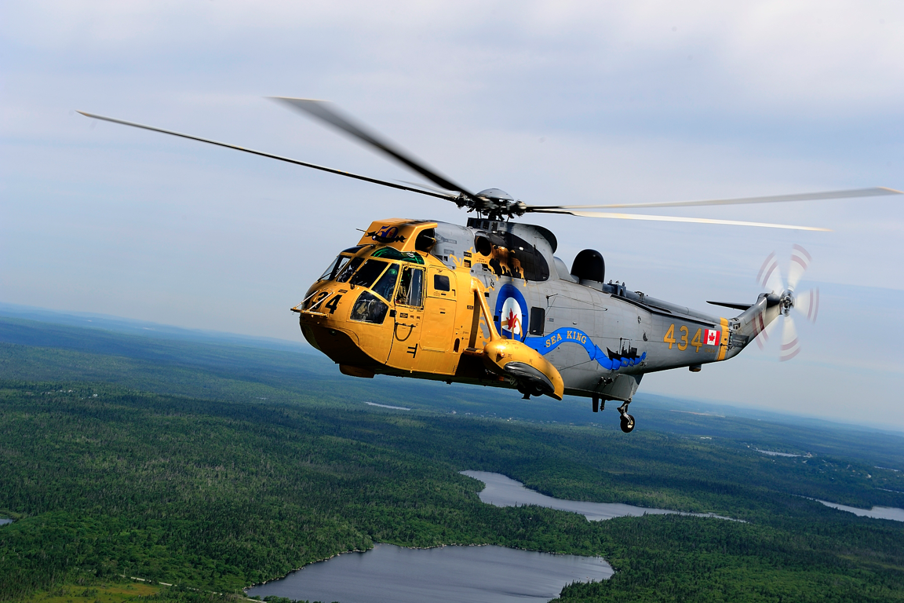
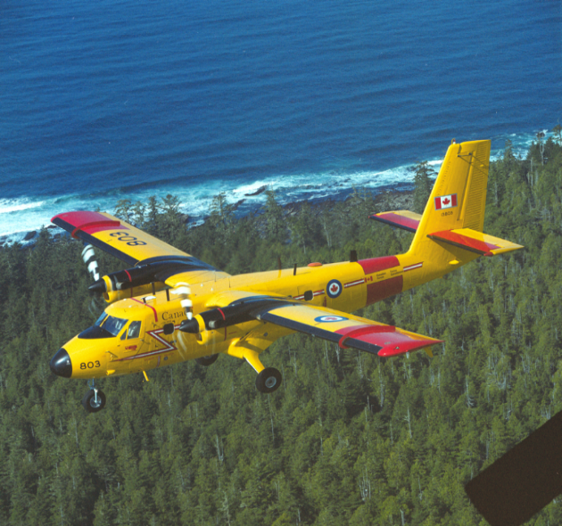
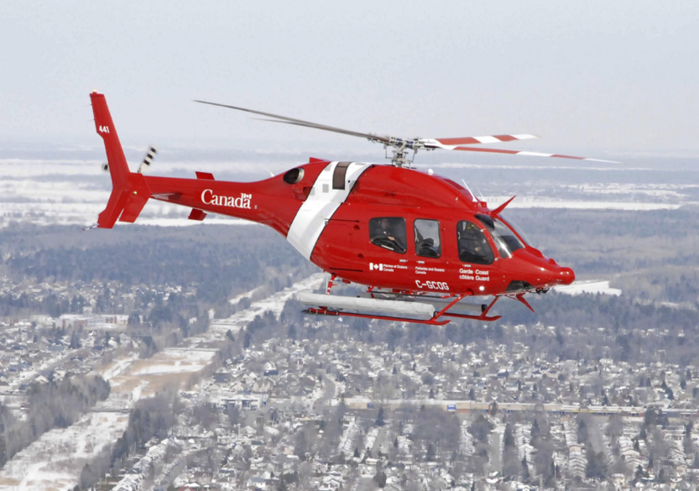
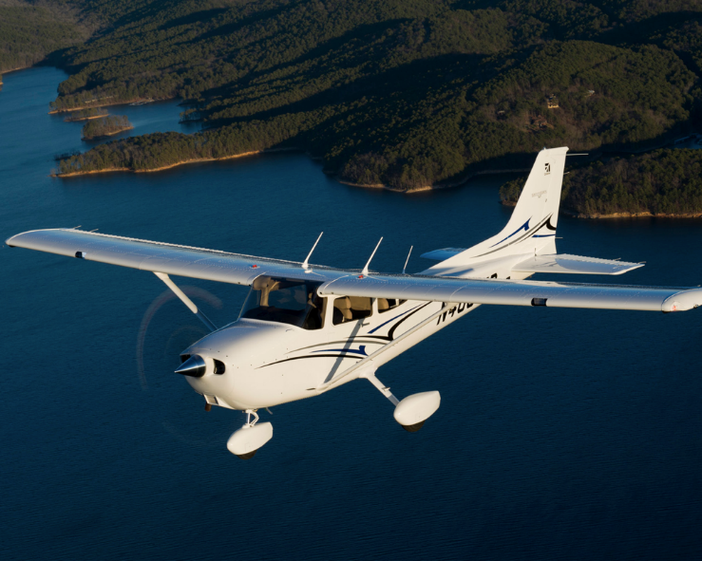
SECONDARY AIR RESOURCES

Slide 19
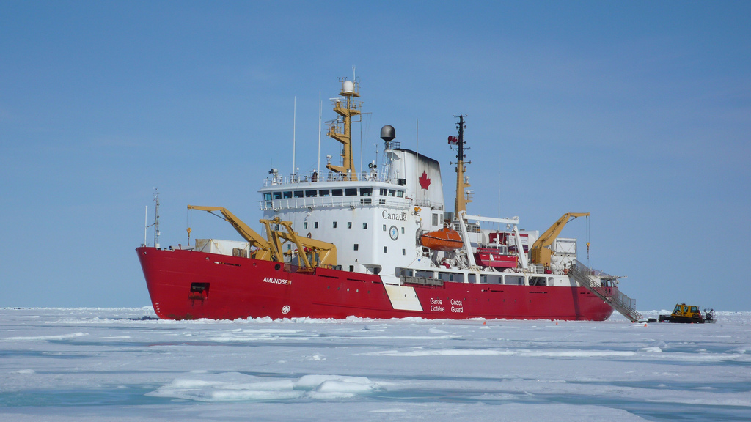
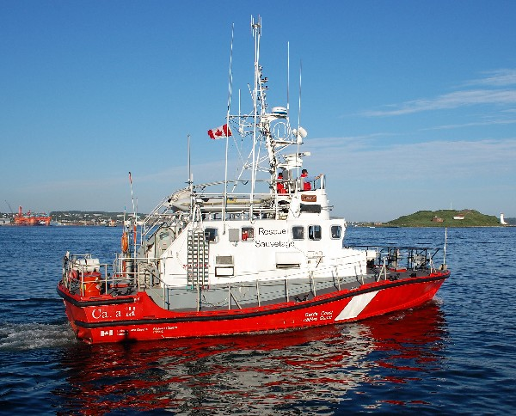
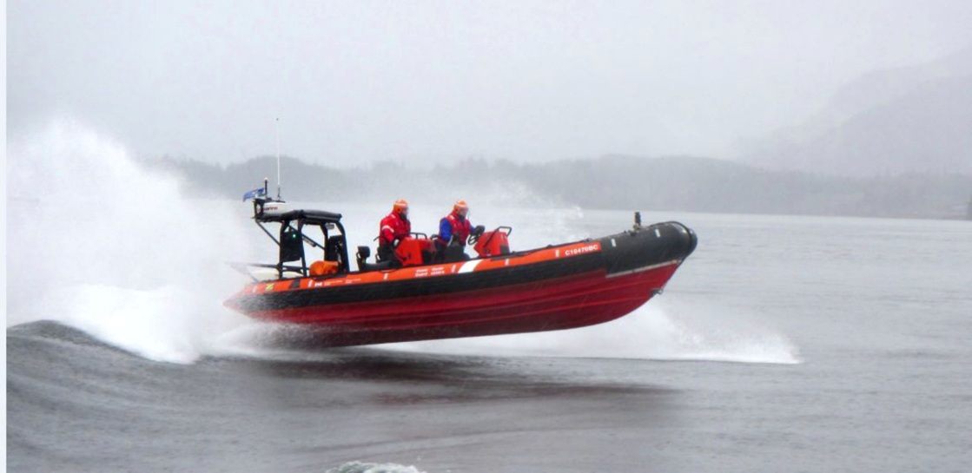
PRIMARY CCG RESOURCES
Large SAR Vessels (over 140’)
ARUN Lifeboats (52’)
Motor Lifeboats (47’)
Inshore Rescue Boats (Summer only)

Slide 20
CCG RESOURCES STANDBY POSTURE
CCG SAR Patrol ships respond immediately when at sea or within 30 minutes when in port or at anchor
Lifeboats and Inshore Rescue Boats respond within 30 minutes

Slide 21
OTHER SAR RESOURCES
DND - all CF vessels and aircraft
DFO/CCG - all vessels and helicopters
CASARA and CCGA
Other Canadian Government vessels and aircraft
Local Agencies, Police, Fire, Ambulance and Ground SAR
Vessels and Aircraft of Opportunity
Commercial Charters (both air and marine)

Slide 22
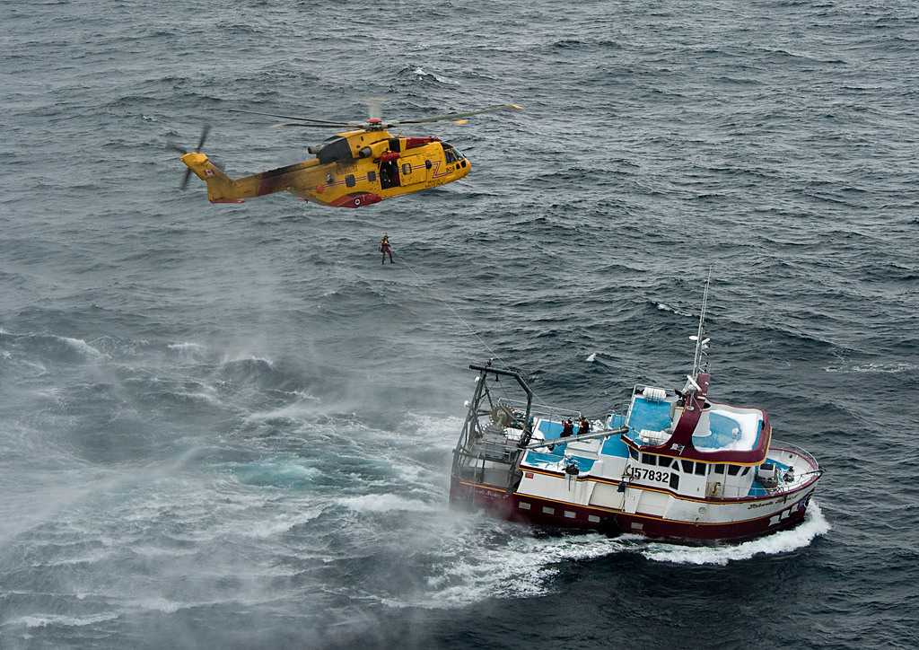
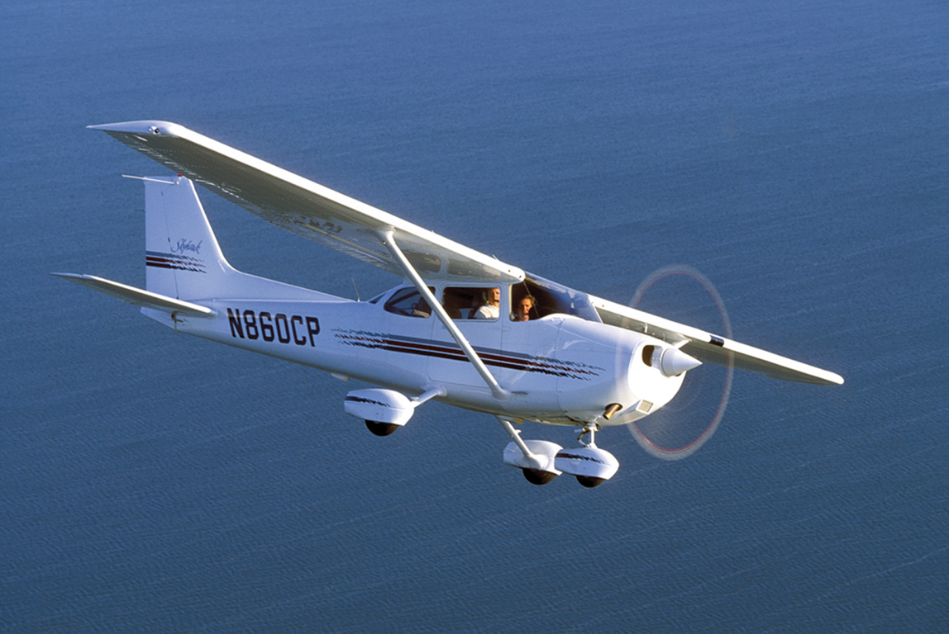
VOLUNTEER RESOURCES
Canadian Coast Guard Auxiliary (CCGA)
Civil Air Search and Rescue Association (CASARA)

Slide 23
Humanitarian SAR
(Secondary Mandate)
Provincial and Territorial responsibility. However, upon request JRCC Halifax will provide Federal Government resources(Air and Marine) to assist:
  critical medevacs from remote location
  search for person lost in the wilderness or missing scuba diver
  hospital to hospital patient transport/transfer

Slide 24
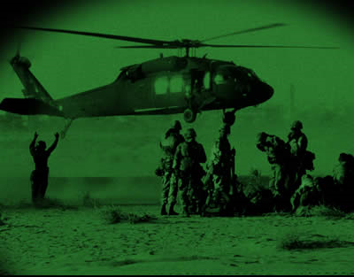
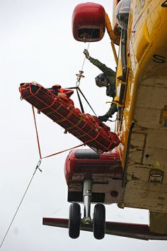
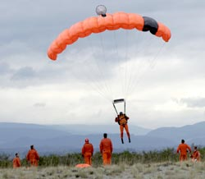
EMO Responsibilities
Ensure resources have been exhausted
  RCMP, Charters, CASARA etc.
  - mission requires specific capabilities…

Slide 25
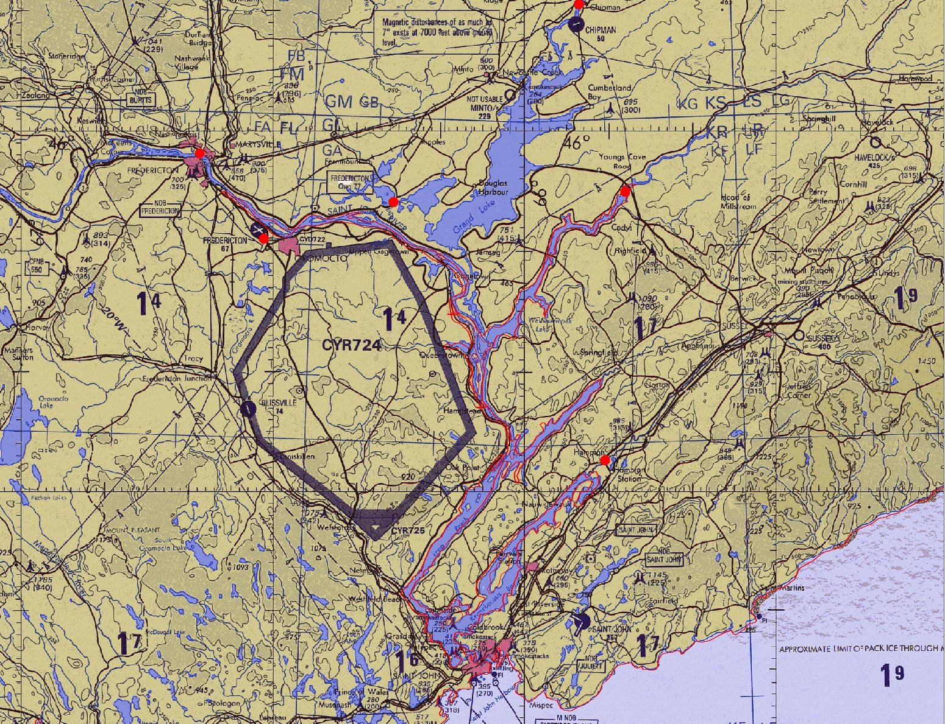
Transition Points

Slide 26
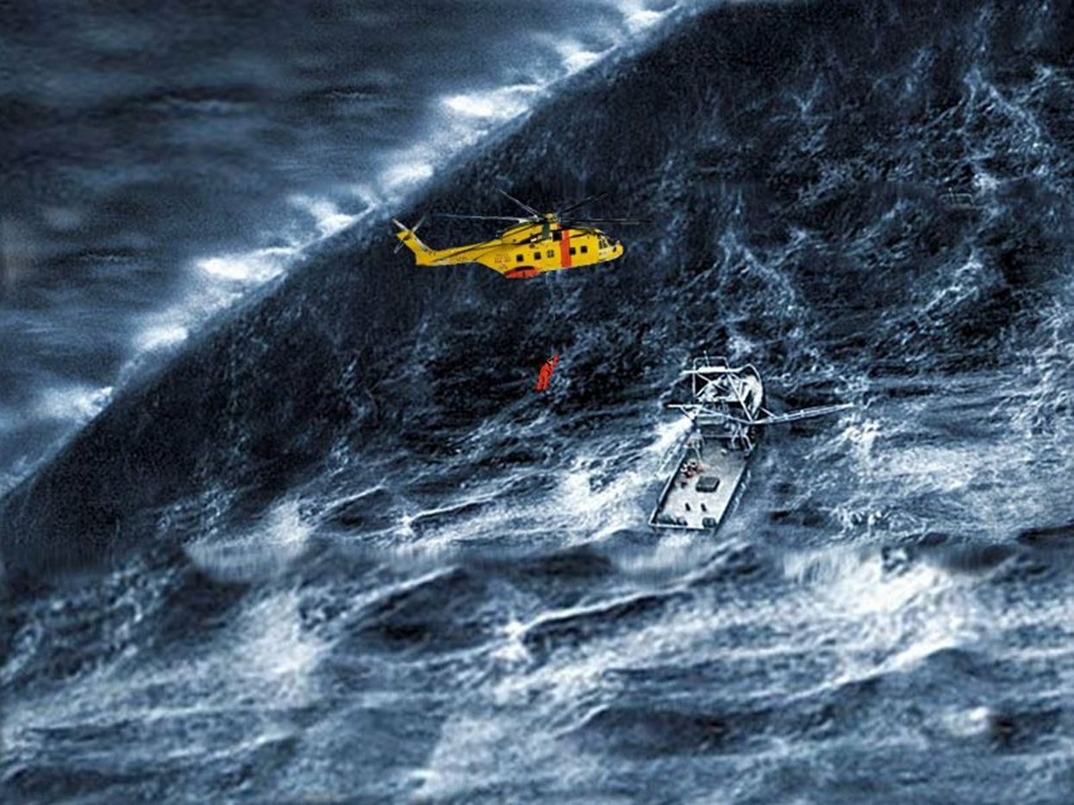
QUESTIONS

