Slide 1

EXERCISE
Brunswick Charlie 2020
MPC

Slide 2

Exercise Brunswick Charlie 2020
Logo

Slide 3
IPC Review
Aim
A province wide exercise designed to allow those responsible for, and involved with, Emergency Management an opportunity to practice planned responses and other procedures.
This exercise like previous ones, will afford participants the opportunity, to challenge their Emergency Management and response components.
Using a new but realistic scenario, and databank of prepared injects to assist communities & add realism.
Notes:
The aim of these provincial exercises is to provide all involved an opportunity or a “platform if you will” to practice Emergency responses that could potentially affect your communities or departments. Allow participants the ability to practice procedures as they relate to planning, mitigation, response and recovery. Additionally it is an occasion to develop contacts and build relationships that are the foundation of successful Emergency response.

Slide 4
Scope
The scope of the exercise, developed provincially, is designed to encourage maximum participation from all municipalities, LSD’s, SAR partners and First Nation Communities within the province, regardless of their level of preparedness.
All communities & emergency management partners are encouraged to participate.
This exercise will present a new scenario that will allow participants the flexibility to prepare for impacts that could affect their citizens.
The Provincial Emergency Operations Centre along with the Regional Emergency Operation Centres will be activated for this exercise.
Notes:
Communities can participate at what ever level they desire, from the basics such as activation and communication to more in depth level for those that have more resources and want a higher level of participation

Slide 5
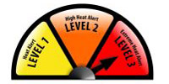
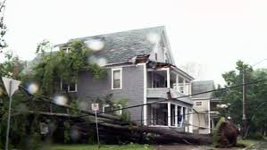
Scenario
A severe heat wave immediately followed by a short duration tropical storm will allow participants a broad scope of potential impacts. (Power outages, health emergencies, evacuations, comms interruptions, industrial accidents, fires, localized flooding, vandalism, lost persons etc…)
Simulated social media, and web based news reporting will add to the realism of the exercise.
Notes:
As you are all well aware it is difficult to come up with an effective scenario that is realistic but has enough flexibility, to allow participants to practice the aspects that they need and want. This year we have decided that a severe heat wave followed by a short duration tropical storm would provide that opportunity.

Slide 6
Reasons to Conduct an Exercise
To practice and evaluate plans, policies and procedures
Identify plan vulnerabilities and gaps in resources
Improve organizational coordination and communications
Clarify roles and responsibilities
Establish working relationships
Improve individual and team performance
Satisfy regulatory requirements
Notes:
The reasons for conducting an exercise are numerous and include establish good working relationships prior to an emergency

Slide 7
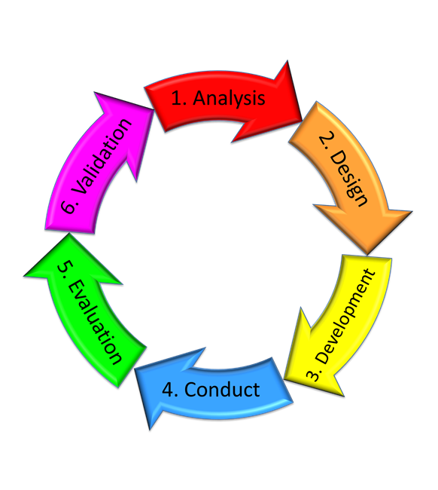
Exercise Design
Notes:
we are still into the development phase.

Slide 8
Target audience
Primary Target Audience for Ex is Municipalities/ LSDs/First Nations communities and their pers
Secondary TA Is organisations within the communities such, fire, police, GSAR etc..
Many other organisations benefit as well PEOC, REOC, Red cross etc…
Exercise Control
Secondary Training Audience
Primary Training Audience
Notes:
The Target Audience is slowly expanding to include GSAR teams, JRCC, RPAS, and others

Slide 9
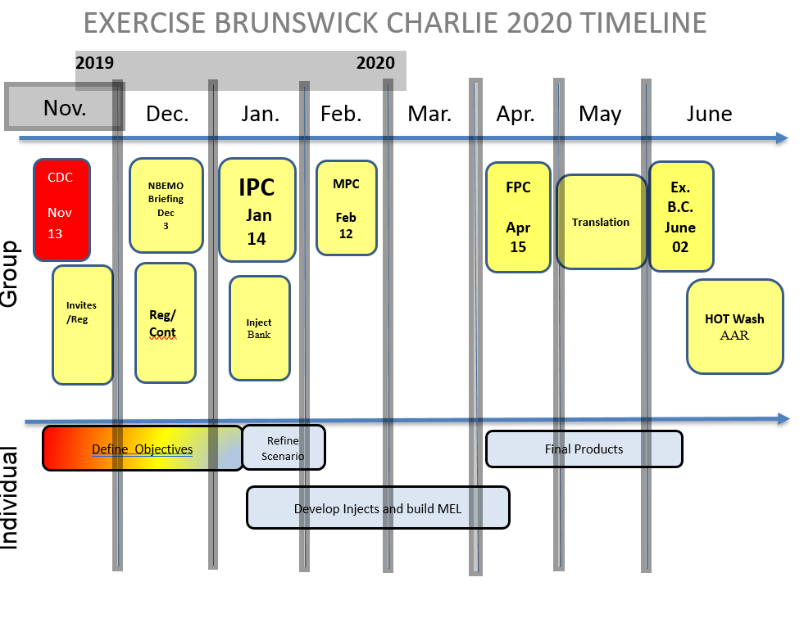

Slide 10
Brunswick Charlie 2020 Website
NBEMO has created a website that provides access and updates on the exercise.
This site provides the latest progress on the exercise design and conduct, and links to other pertinent information and feeds.
List of participants
The site can be accessed by going to: www.gnb.ca/brunswickex
Notes:
The province has made a website that is updated regularly, anyone wishing to obtain a copy of the Power points will be able to find them there.

Slide 11
Participants
There will be a number of participants including:
The New Brunswick Emergency Measures Organization
Provincial/Regional Emergency Action Committees
The Canadian Armed Forces, through Joint Task Force Atlantic
Environment and Climate Change Canada
Regional Emergency Management Coordinators
Participating New Brunswick communities
GNB partners and organizations to be identified
Notes:
Other includes any Org or department that may wish to participate, such as industries and service providers

Slide 12
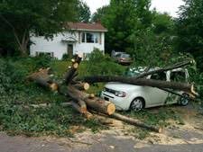
Exercise Objectives
NBEMO Objectives remain the same as previous exercises:
Activation of Municipal / local EOC’s
Exercise local emergency response plans
Communications at all levels
Reporting requirements
Create discussion on State of Local Emergency/State of Emergency
Create discussion on Request for
Assistance & Provision of Services (CAF)
Provide SAR partners an opportunity to participate
Local Objectives
To be established at the local level
Notes:
Local objectives can be pretty much anything you would to achieve!
Small communities might just want to exercise activation and communications.
Others may want to test plans, or practice procedures such as, evacuation of a nursing or special care home, setting up of a reception centre, responding to a problem at a larger community complex.
Still other communities or Organisations that have more resources may want to exercise more complicated scenarios such a downed plane, severe fires, mass casualties etc…

Slide 13
Key Dates
Initial Planning Conference (IPC) – 14 Jan. 0900-1500hrs
Main Planning Conference (MPC) – 12 Feb. 0900-1500hrs
Final Planning Conference (FPC) – 15 April. 0900-1500hrs
Exercise Brunswick Charlie - 02 Jun. 0900-2000hrs throughout the province
Notes:
All planning conferences will be WebEx based but all are encouraged to attend in person.

Slide 14
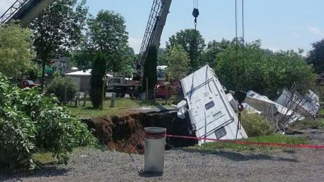
After Action Review
All participants are encouraged to self-evaluate.
Best practices and important lessons learned should be shared – NBEMO will compile points.
NBEMO AAR template will be located on the Ex webpage
Notes:
We will walk before we run and therefore will be no formal evaluation. NBEMO working group will produce a form for the participants to provide feedback on the overall exercise.

Slide 15
Trusted Agents
As indicated during the IPC, exercise design will include what is known as “Trusted Agents” who are not exercise players
TA’s are exercise controllers that represent participants during the building of the exercise.
TA’s are responsible for providing injects or exercise activities for the municipality they represent.
REMC’s should co - ord for all their region’s participants
NBEMO (co-ord all injects into the MEL).

Slide 16
MPC Aim and Outputs
Conference Aim:
  The aim of the Ex BRUNSWICK Charlie 2020 (BC20) Main Planning Conference (MPC) is for all Trusted Agents (TAs) to clearly specify any concerns with the proposed Draft Master Event List (MEL), in order to ensure they are set up to achieve their organizational objectives.
Meeting Outputs:
  Solidify the Scenario
  Partners to clearly specify any concerns WRT achieving their objectives due to the proposed MEL structure; and
  Trusted Agents to write or assist in writing specific injects prior to the FPC.
Notes:
The overall aim of the Main planning conference is to allow trusted agents the opportunity to raise any concerns they may have with reaching their organisations objectives.
Additionally we are using these conferences as an opportunity to allow key organisations within the Emergency Management community to educate us on what resources they provide.

Slide 17
Organizations Registered
Irving Oil Refinery
Canterbury
Perth Andover
ANB
Carleton Manor Inc
PS Can
CAF
Justice
DTI
NB Power
EECD
OPSA
Policing Services
Lac Baker
Campbellton
DERD
ELG
Health
RCMP
SD
DPS – Enforcement/Sherriff
Alma/Hillsborough/Riverside-Albert
Quispamsis
Saint John
Port SJ
SJ Airport
Cap Pele
Hampton
Neguac
Notes:
To date we have 12 municipalities and 19 organisations or departments that have registered, so if you have not completed the questionnaire/ Registration please do so NLT 15 Feb.

Slide 18
Scenario Background
The last few days of May have set near record-breaking temperatures as a heat wave impacted the province
The heat wave broke with the passage of a powerful post tropical storm, CHARLIE, which affected the province beginning late on Monday June 1 bringing heavy rain and intense wind across the province.
The combination of astronomical and meteorological conditions will result in several sites exceeding stage 4 (major flooding).
Many coastal communities will likely exceed stage 4 (major flooding) Monday evening into Monday night.
Notes:
The scenario for the exercise remains the same a heat wave followed a short duration tropical storm. The heat wave has also significantly increased the fire index. With the potential for woodland interface

Slide 19
Scenario Warm Start
A record setting heat wave has been impacting the province for three days followed by a high intensity tropical storm.
The province is experiencing significant impacts, power outages due to increased demand and downed lines, municipal water supply problems, many hospitals working well above capacity, school closures.
Local impacts include inland and coastal flooding, road and culvert wash outs, forest fires in the northern part of the province.
Increased demand on the first responder community.

Slide 20
Scenario Warm Start what have we done
PEOC activated
REOCS activated
Critical Infrastructure impact assessment and mitigation being coordinated by NB Security Directorate.
NBEMO & Dept of Health issued Public Advisories.
DTI crews fully mobilized to address road closures.
Communications through NBEMO and NB Power will be aligned to get messaging out to the public.
Coordination with Bell Aliant to resolve emergency communication and cell phone outages.
NB Power has activated EOC and conducting assessments for posting of ETRs
Health preparing news release on food handling during power outage.
Notes:
Prior to Exercise day the PEOC and REOC’s will have been activated, as well there would be a series of other activities or actions

Slide 21
Scenario Timeline
    Exercise to occur from 8 am – 8 pm 2 June 2020 (actual date), with warm start commencing 26 – 29 May (build up to heat wave) 29 to 31 May (heat wave), 1 June (tropical storm).
    Heat wave will be causing heat related impacts that communities are dealing with. Then on 1st June the tropical storm will not only complicate the impacts already being dealt with, but cause a new set.
May
June
26
27
28
29
30
31
1
2
3
Scenario warm start, ECCC updates, Social Media, Test
Heat Wave
Tropical Storm
EX Day
0800-2000 hrs

Slide 22

Notes:
JTFA has engaged Hope Carr to provide media products such a VNN and Chit Chat. Hope will provide a detail update later today.

Slide 23
EXERCISE PRODUCTS
NBEMO will create an Exercise Manual containing all info required to manage exercise (player handbook and TA handbook);
NBEMO will create MEL (Master Events List)
JTFA will provide exercise social media and exercise news media;
ECCC has created the weather package for the exercise; and
NBGSARA will develop an exercise within an exercise to simulate a major search

Slide 24
Exercise Control (EXCON)
Do you, as TAs, understand what your responsibilities/roles will be during the conduct of the exercise?
As an EXCON player you will be overseeing how the exercise unfolds as it relates to your individual organization. This is why you are helping to build the MEL and develop the exercise. ***This is knowledge that is NOT to be made available for those being exercised***
How do you plan on keeping your organization “on track” and moving forward? Are you prepared to do this?
You need to identify ahead of time from where and how you will be delivering the inject?
Do you know what you have to do prior to the ex taking place to ensure you are set up for it?
Notes:
We want to make sure that all key pers understand what they have to do in order for their exercise experience to be a successful one.
You as TAs have responsibilities to ensure that certain things are in place when the ex kicks off and that the ex unfolds in a smooth manner. As well as what you are going to do if things do not go as planned. Don’t be afraid to take advantage of opportunities to exercise the players further than planned.

Slide 25
Reminder
All Exercise correspondence is to start with Exercise Exercise Exercise and end with Exercise Exercise Exercise
All conversations are to start with Exercise Exercise Exercise

Slide 26
Exercise Calendar
14 Jan – IPC
21 Jan - Inject bank posted on website
29 Jan- working group with key pers
12 Feb – MPC
31 Mar – All injects must be received!
15 April –FPC
15 May- translation complete
22 May – Player guides/ EXCON manual and MEL distributed.
26/27May -Warm start
28/29 May – test social media access (warm start continues)
30/31 May (warm start cont)
01 June – Short duration tropical storm breaks heat wave
02 June Exercise Brunswick Charlie (Hot wash)
10 June- Hotwash points returned to NBEMO

Slide 27
Prior to the FPC
Ensure your organizations’ objectives are being achieved through the way the ex is unfolding based off of the proposed MEL structure
Ensure you understand what your responsibilities as EXCON will be on the day(s) of the ex.
Ensure you are getting everything ready for your individual organizations needs come the day of the ex. I.e. individual coordination.
Ensure you have the contact info for those persons you will need to get in touch with during the ex.
Contact the Ex Planners if you have any questions.
Further develop injects and submit prior to the FPC (NLT 31 Mar) to allow time to process and translate.

Slide 28
Questions?

